Slide 1
Mid-Term Report
Juweek Adolphe Zhaoyu Li
Ressi Miranda Dr. Shang

Slide 2
Outline (Edited)
Learning Experience
Machine Learning
Sentiment Analysis
Project
Results

Slide 3
Learning Experience
Machine Learning Algorithms
Naive Bayes (probability)
Support Vector Machine (SVM)
Stochastic Gradient Descent

Slide 4
Learning Experience
Sentiment Analysis
classify text into a polarity
Text Classification into polarity categories
Naive Bayes: Bernoulli
Naive Bayes: Multinomial
Stochastic Gradient Descent
TF-IDF (Term frequency - inverse document frequency)
Chi-Square Test
Notes:
Stochastic Gradient Descent was used because it works faster and more efficiently.

Slide 5
Why?
Improve the accuracy of the algorithms
Even by a little bit
Hope to get better results

Slide 6
Scheme/Project
Let’s make a comparison between the different algorithm
Comparing the algorithms accuracies
Changing up features extraction

Slide 7
Methodology
Extracting features
Make a feature vector
Select features
Remove features
Train Algorithm
Test Algorithm

Slide 8
Issues
Long time to train and cross-validate different Pipelines
Formatting of code prevented inclusion of alternative classifiers (KNearestNeighbors, DecisionTree)
Data set format might not be reliable (already processed)
Accuracy rates lower than expected

Slide 9
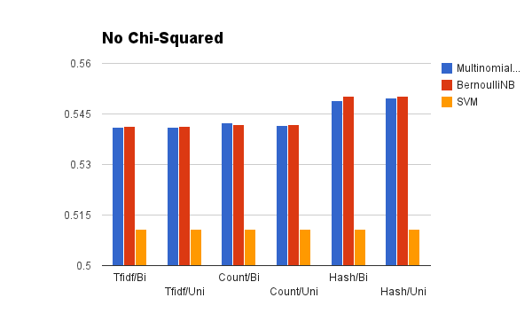
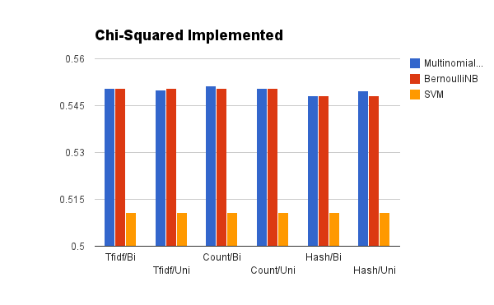
Results

Slide 10
Results
No Chi-Squared
 | Tfidf/Bi | Tfidf/Uni | Count/Bi | Count/Uni | Hash/Bi | Hash/Uni
MultinomialNB | 0.550637716 | 0.550101526 | 0.55132977 | 0.550564977 | 0.548096016 | 0.549712898
BernoulliNB | 0.550633557 | 0.550633557 | 0.550633557 | 0.550633557 | 0.548104329 | 0.548104329
SVM | 0.51090564 | 0.51090564 | 0.51090564 | 0.51090564 | 0.51090564 | 0.51090564
Chi-Squared Implemented
 | Tfidf/Bi | Tfidf/Uni | Count/Bi | Count/Uni | Hash/Bi | Hash/Uni
MultinomialNB | 0.541179586 | 0.540986305 | 0.542239491 | 0.541505867 | 0.548867048 | 0.549660941
BernoulliNB | 0.541210758 | 0.541210758 | 0.541809294 | 0.541809294 | 0.550138938 | 0.550138938
SVM | 0.51090564 | 0.51090564 | 0.51090564 | 0.51090564 | 0.51090564 | 0.51090564

Slide 11
Results
No Chi-Squared
 | Tfidf/Bi | Tfidf/Uni | Count/Bi | Count/Uni | Hash/Bi | Hash/Uni
MultinomialNB | 0.550637716 | 0.550101526 | 0.55132977 | 0.550564977 | 0.548096016 | 0.549712898
BernoulliNB | 0.550633557 | 0.550633557 | 0.550633557 | 0.550633557 | 0.548104329 | 0.548104329
SVM | 0.51090564 | 0.51090564 | 0.51090564 | 0.51090564 | 0.51090564 | 0.51090564
Chi-Squared Implemented
 | Tfidf/Bi | Tfidf/Uni | Count/Bi | Count/Uni | Hash/Bi | Hash/Uni
MultinomialNB | 0.541179586 | 0.540986305 | 0.542239491 | 0.541505867 | 0.548867048 | 0.549660941
BernoulliNB | 0.541210758 | 0.541210758 | 0.541809294 | 0.541809294 | 0.550138938 | 0.550138938
SVM | 0.51090564 | 0.51090564 | 0.51090564 | 0.51090564 | 0.51090564 | 0.51090564

Slide 12
Findings
MultinomialNB and BernoulliNB dramatically outperformed SGD
Chi-squared generally reduces accuracy (30%)
Highest overall was about Count/Multinomial/Uni+Bi
No consistent correlation between difference in accuracy and usage of unigrams vs bigrams

Slide 13
What does this mean?
We do not know
Classifier can stand to be more accurate
Experiments with additional datasets/algorithms have to be completed first
Overall goal to scale to Big Data level

Slide 14
Future Work
Figure out what makes our classifier less accurate from the standard
No improvement
Moving away from the previous project
Previous projects were reinventing the wheel
Implementing Naive Bayes in MapReduce

Slide 15
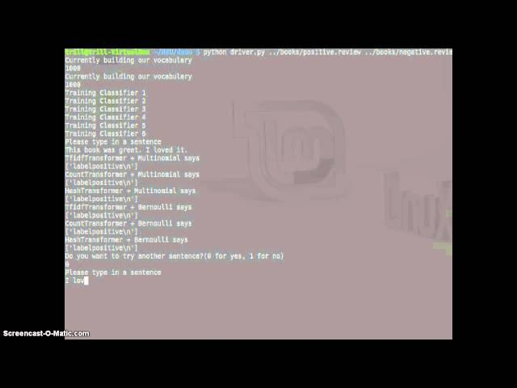
Demo of Text Classification

